Slide 1

SCRIPT RECOGNITION WITH MULTI-LINGUAL TRANSLATION
CP442: PROJECT-II
Guide:
Dr. H.D.Vasava
Professor of Computer Engineering
Dr. P.B.Swadas
Professor of Computer Engineering
Submitted by
1. Jignasa Parikh (16CP024)
2. Seby Amin (16CP031)

Slide 2
Contents
Problem Overview
Aim
Objective
What we had to do overall!
Method we approached..
Flow diagram
Implementation
  Pre-processing
  Line segmentation
  Word segmentation
  Dataset creation
  Model creation and prediction
  translation
Applications
Limitation
Future Scope
References

Slide 3

Problem overview:
Worried of converting your handwritten assignment to text file?

Slide 4


problem overview
Frustrated by seeing the language you are unaware of?

Slide 5
AIM
Creating a module to recognize the script (detect image), extract image and translate it to user-defined language.

Slide 6
objective :
To transform image text into appropriate plain text.
To translate the plain text obtained through the above processing to user-friendly language.

Slide 7
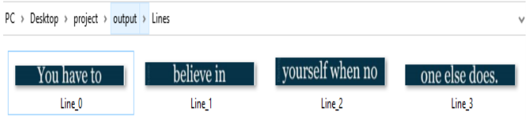
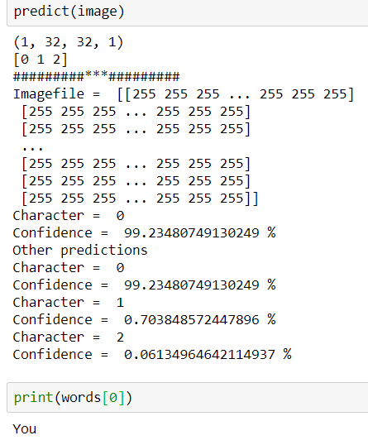
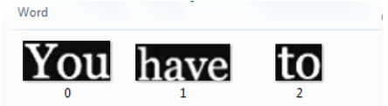
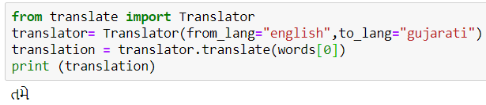
What we had to do overall!

Slide 8
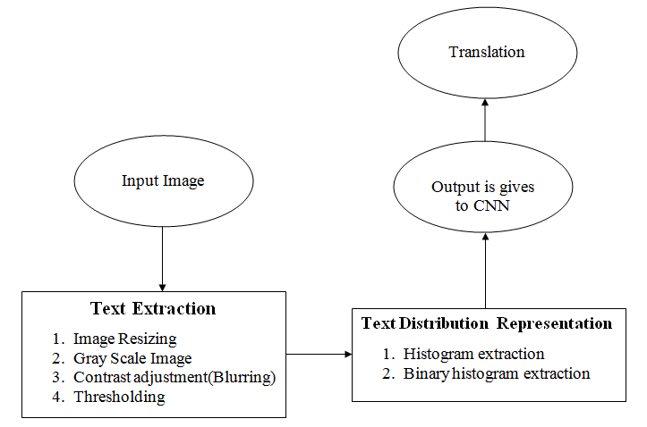
method we approached..

Slide 9
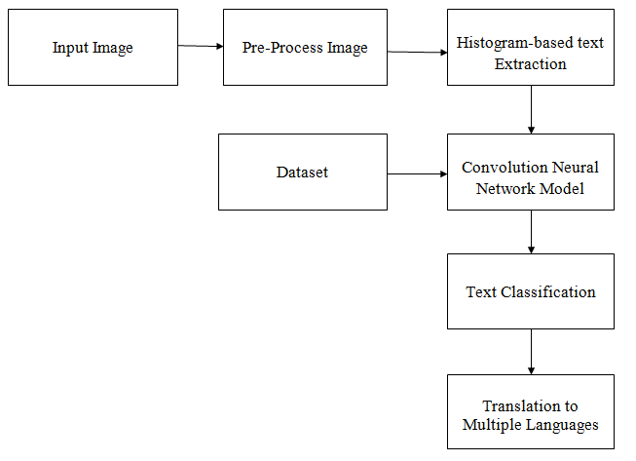
Flow diagram

Slide 10

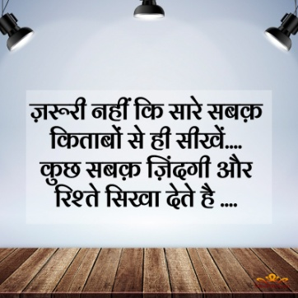
implementation
Input Image:
The module takes text image as input which has to be classified into valid text of a particular language(here English and Hindi).

Slide 11
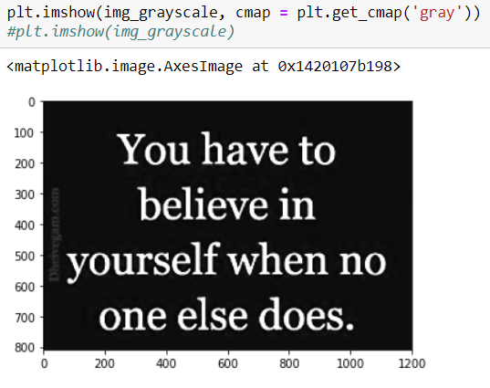
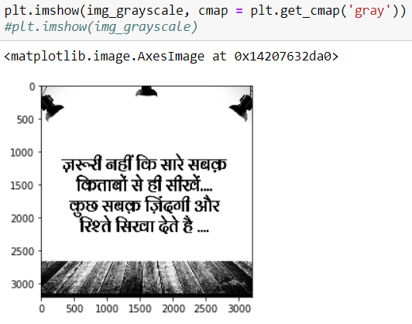
Implementation (pre-processing)
Normalization(Gray-Scaling):
These images are then normalized and converted to gray scale to reduce its size and precisely for faster execution of the program.

Slide 12
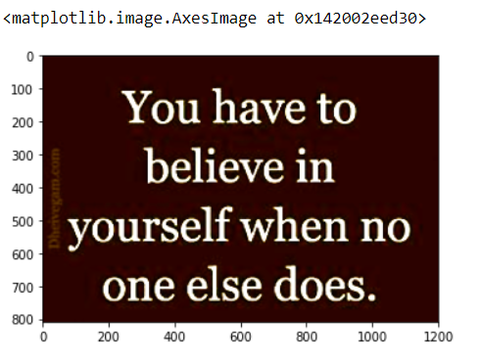
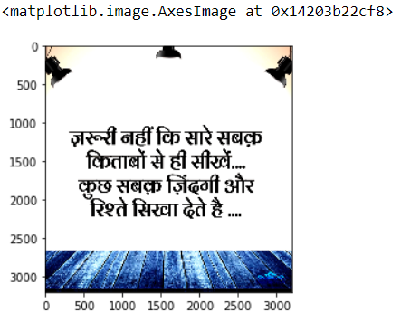
Implementation (pre-processing)
Blurring:
For fine extraction of each and every word in the text, blurring and then thresholding image plays a vital role in its processing.

Slide 13
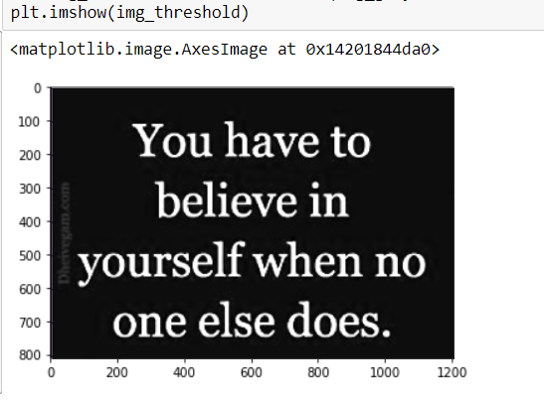
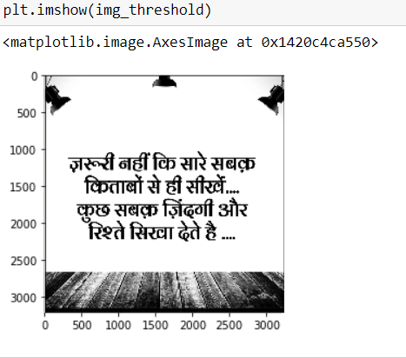
Implementation (pre-processing)
Thresholding:
Otsu’s Binarization :- This method gives a threshold for the whole image considering the various characteristics of whole image(like lighting, conditions, contrast, sharpness etc.) and that threshold is used for Binarizing image.

Slide 14
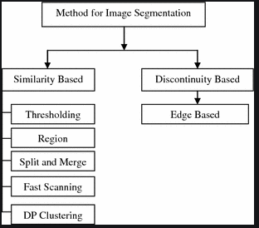
image processing (text extraction)

Slide 15
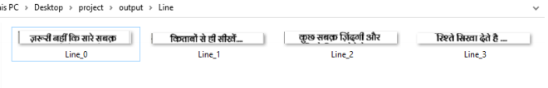
Line Segmentation
From threshold image, find contours
Form regions
Scan vertically, to separate lines
Save the lines

Slide 16
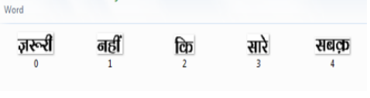
Word segmentation
Get the lines as input
Scan horizontally segment words
Save the word image

Slide 17
Creating Dataset
Generated word images in different font sizes and styles.
Formation of dataset by:
  Replicating word images into 1000 images
  With distortion level =4 (1 being lowest and 10 being highest)
  Different sizes of words were generated using the parameter of breadth and height with probability distribution of 0.8.
These images are given to train the model.

Slide 18
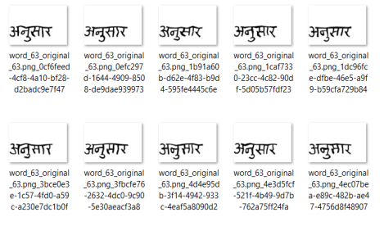
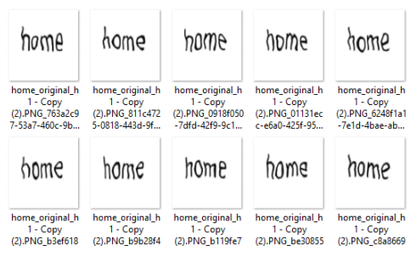
Dataset image

Slide 19
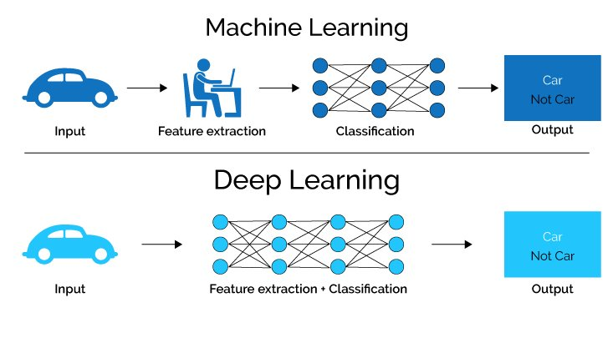
Deep learning

Slide 20
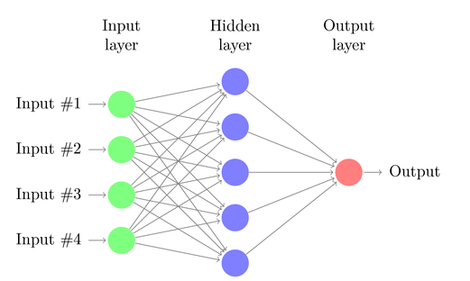
Convolution Neural Network (Cnn) :
Regularized MLP, inspired by neurons in human brain
network learns features of each class of image to classify
Hidden layers consists of series of convolution layers discussed in next slides…

Slide 21
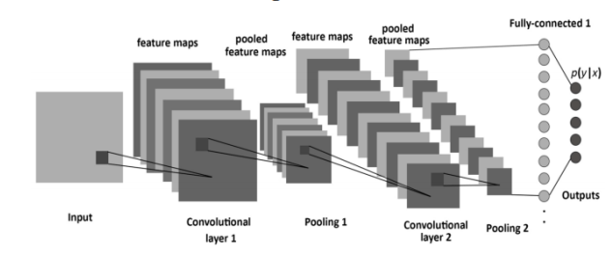
Layers in Cnn :
CNN has four Type of layers as follows –
    1. Convolutional Layer (CONV)
    2. Rectified Linear Unit Layer (ReLu)
    3. Pooling Layer (POOL)
    4. Flatten Layer

Slide 22
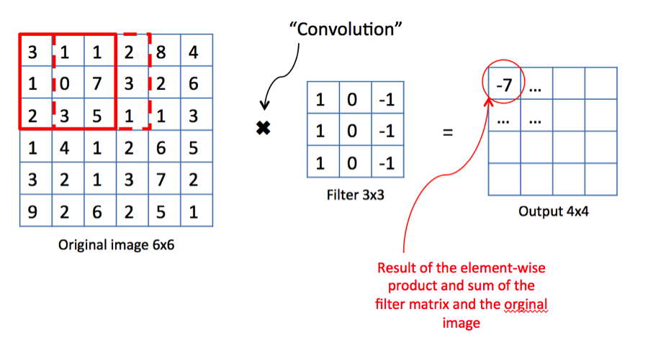
Layers in cnn: convolutional
Input image matrix * filter = result of convolve layer
preserves the relationship between pixels by learning image features using small squares of input data.

Slide 23
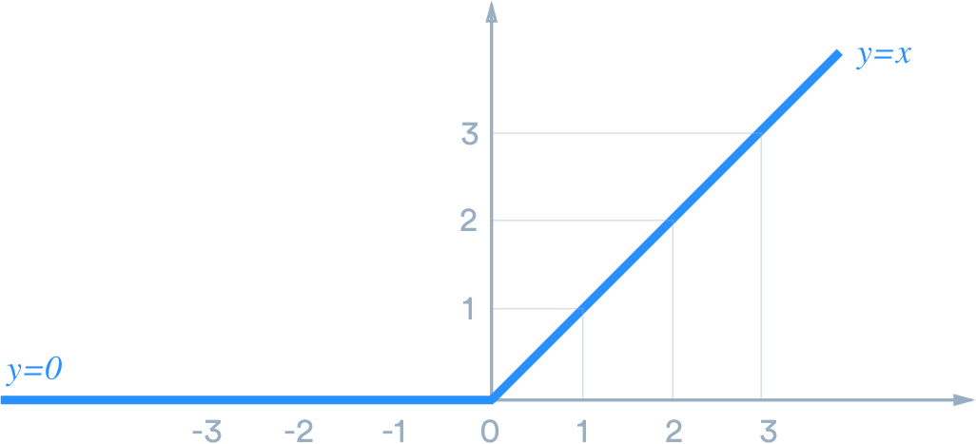
Layers in CNN: Rectified Linear Unit Layer (ReLu):
piecewise linear function
f(x)=max(0,input matrix)

Slide 24
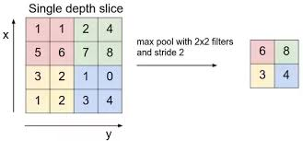
Layers in Cnn: Maxpooling
sampling or compressing the dimensions of the input image.
Filter can be 2x2 or 3x3 as per the requirement.

Slide 25
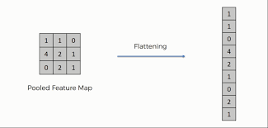
Layers in cnn: Flatten layer
transforms a 2D matrix of features into a vector
Ready to fed into a fully connected neural network classifier.

Slide 26
Model creation: Sequential model:
Keras model, allows to create models layer-by-layer
way of creating deep learning models where an instance of the Sequential class is created to add layers and modify it.
Create model by:
  Adding batch size to compute training of images (32,64,128,etc)
  Provide proper loss function
  better performing optimizer
  Accuracy matrix

Slide 27
Learning model:
An optimizer:
could be string identifier of an existing optimizer (such as rmsprop or adagrad or adam) or an instance of the Optimizer class.
A loss function:
This is the objective that the model will try to minimize. It can be the string identifier of an existing loss function (such as categorical_crossentropy or mse), or it can be an objective function.
A list of metrics:
For any classification problem you will want to set this to metrics=['accuracy']. A metric could be the string identifier of an existing metric or a custom metric function.

Slide 28
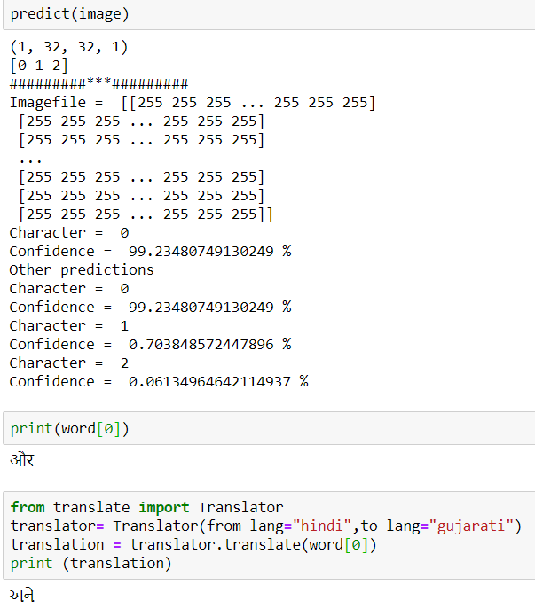
Prediction :

Slide 29
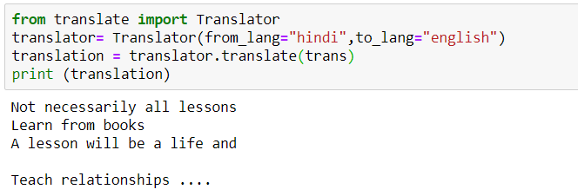
translation
translate module for its translation to user-preferred language.
Accuracy of this translation totally depends on the accuracy of text extraction from the entire module of this project. .

Slide 30
Applications
To digitalize printed data records, can be Passport Documents, Invoices, Bank Statements, Business Card, Mail or Other Documents.
used in Machine Processes as Machine Translation, Text-to-Speech, Key Data and Text Mining

Slide 31
Limitations:
Different deep learning methods can be approached for different language image detection
Type of image always affects output

Slide 32
future scope
Translation module can be explored for grammatically correct sentences.
Modification to OCR can help in faster digitalizing world.
Better scanning tools can be developed to capture images properly

Slide 33
references
Abdelmalek Amine, ZakariaElberrichi, Michel Simonet, ' AUTOMATIC LANGUAGE IDENTIFICATION: AN ALTERNATIVE UNSUPERVISED APPROACH USING A NEW HYBRID ALGORITHM' , International Journal of Computer Science and Applications, ©Technomathematics Research Foundation Vol. 7, No. 1, pp. 94 – 107, 2010.
S.BanuChitra, DrR.S.Vetrivel, 'TEXT RECOGNITION USING DIGITAL IMAGE PROCESSING TECHNIQUES', International Journal of Computer Engineering and Applications, Volume XII, Issue I, Jan. 18.
Ms. N. Geetha, Dr. E. S. Samundeeswari, ' Image Text Extraction and Recognition using Hybrid Approach of Region Based and Connected Component Methods' , International Journal of Engineering Research & Technology (IJERT) IJERT ISSN: 2278-0181, Vol. 3 Issue 6, June – 2014
Basavaprasad B, Ravi M, ‘ A comparative study on classification of image segmentation methods with a focus on graph based techniques’, , International Journal of Engineering Research & Technology (IJERT) IJERT pISSN: 2319-1163, Vol. 3 Issue 03, May – 2014

